Slide 1

Intelligent AIOps Framework for Predictive CI/CD
Pipeline Management and Autonomous Resource
Optimization
Tejas Annasaheb Jagtap
MTech Information Security
712442021
Guide: Dr. V. K. Pachghare
Dept of Computer Science and Engineering
COEP Technological University, Pune

Slide 2
Content
Introduction
Literature Survey
Research Gap
Problem Statement
Research Objectives
Proposed High Level System Design
Current Implementation Status
References
Dept of Computer Science and Engineering
COEP Technological University, Pune

Slide 3
Introduction
Modern software systems rely heavily on continuous integration and continuous deployment (CI/CD) pipelines
These pipelines generate massive volumes of logs and metrics
DevOps teams struggle with:
  Unpredictable build failures
  Manual debugging of logs
  Reactive (not proactive) scaling decisions
artificial intelligence for IT operations (AIOps) integrates Machine Learning + Automation to enhance CI/CD reliability
Dept of Computer Science and Engineering
COEP Technological University, Pune

Slide 4
Motivation
Frequent build failures lead to deployment delays
Manual root-cause analysis is slow and error-prone
Traditional autoscaling in Kubernetes reacts after resource spikes occur
DevOps teams spend significant effort analyzing logs and failures
Need for an automated, self-learning system that:
  Predicts failures early
  Detects anomalies immediately
  Allocates resources proactively
Reduces operational burden and improves delivery speed
Dept of Computer Science and Engineering
COEP Technological University, Pune

Slide 5
Literature Survey
Sr. No. | Paper Name | Work Done | Limitations
1 | Enhancing Machine- Learning-Based Autoscaling for Cloud Resource Orchestration(2024) | Evaluates ML models for autoscaling cloud applications; compares feature sets and model architectures for predicting load and controlling scale actions. | Focuses on autoscaling alone; lacks integration with CI/CD signals or log anomaly inputs. Does not address end-to-end AIOps orchestration across prediction, anomaly detection and scaling.
2 | Time-series Forecasting-Based Kubernetes Autoscaling using Facebook Prophet and LSTM (2025) | Proposes a hybrid forecasting approach (statistical + LSTM) to predict cluster metrics and drive scaling decisions; evaluates forecast horizons and autoscale rules. | Good forecasting results, but work evaluates autoscaling in isolation and does not incorporate CI pipeline or log features (failure predictions/ anomalies). Limited discussion on real-time log integration.
Dept of Computer Science and Engineering
COEP Technological University, Pune

Slide 6
Sr. No | Paper Name | Work Done | Limitations
3 | Deep Learning for Multivariate Time-Series Anomaly Detection: A Survey (2024) | Comprehensive survey of reconstruction-based anomaly detectors (autoencoders, VAEs, PCA, etc.) for multivariate time series; benchmarks methods and discusses thresholds. | Survey-level work; does not present an integrated DevOps pipeline case. Guidance on thresholding useful, but lacks concrete application to text-based CI logs (TF-IDF → Autoencoder pipeline).
4 | Towards Optimization of Anomaly Detection in DevOps (2023) | Applies deep learning techniques for detecting anomalies in monitoring and log data in DevOps contexts; experiments with representation learning and feature selection. | Focuses mainly on monitoring metrics rather than long textual console logs; limited exploration of the combination of supervised failure prediction and unsupervised log anomaly detection.
5 | AI-Enhanced Platform Engineering: Revolutionizing CI/CD Pipelines Through Intelligent Automation (2021) | High-level study describing application of AI across CI/CD: predictive alerts, log triaging, and smart orchestration; includes case studies and proposed architecture patterns. | Conceptual and high level; lacks detailed experiments, concrete model evaluation, or implementation of a closed-loop autoscaler integrating failure predictions and log anomalies.
Dept of Computer Science and Engineering
COEP Technological University, Pune

Slide 7
Research Gaps
No unified AIOps framework combining:
  Build failure prediction
  Log anomaly detection
  CPU forecasting
  Predictive autoscaling
Lack of predictive autoscaling
Limited real-world CI/CD datasets
Lack of closed-loop automation integrating Jenkins → ML → Kubernetes.
Dept of Computer Science and Engineering
COEP Technological University, Pune

Slide 8
Problem Statement
“To design and implement an intelligent AIOps-based framework that can proactively predict CI/CD pipeline failures, detect anomalies in Jenkins logs in real time, and autonomously optimize Kubernetes resources through predictive autoscaling.”
Dept of Computer Science and Engineering
COEP Technological University, Pune

Slide 9
Research Objectives
To Develop Data Collection Framework for CI/CD and Cluster Metrics
To Build Machine Learning Models for Failure Prediction, Anomaly Detection, and CPU Forecasting
To Implement a FastAPI-Based AIOps Orchestrator for Intelligent Decision-Making
To Design a Predictive Autoscaling Engine for Kubernetes Using ML Outputs
Dept of Computer Science and Engineering
COEP Technological University, Pune

Slide 10
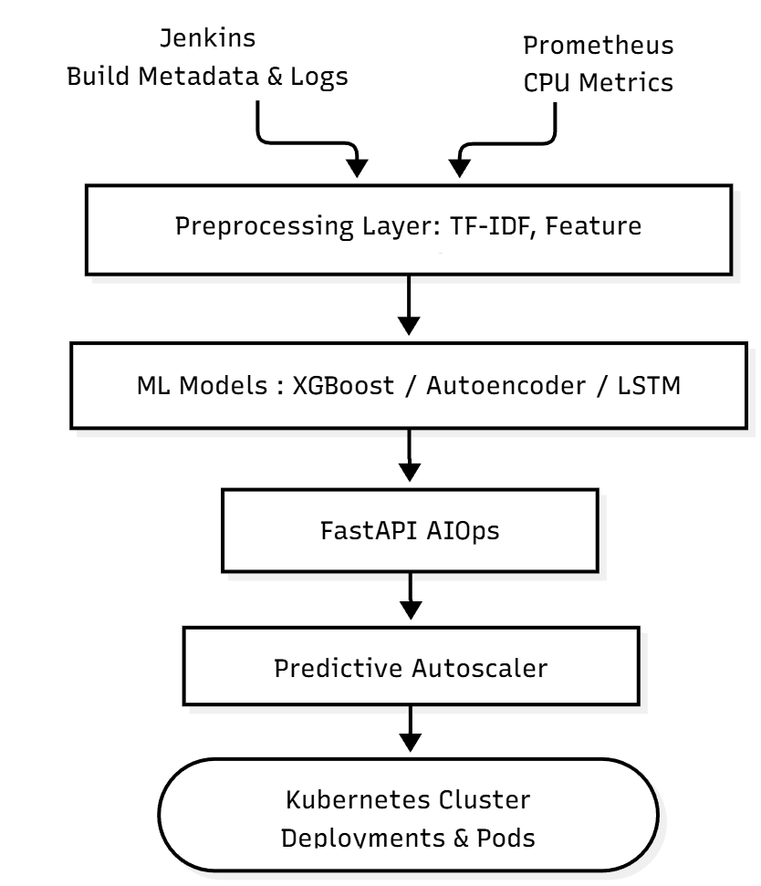
Proposed High Level System Design
Components:
Data Collectors
  Jenkins API for logs + metadata
  Prometheus for CPU metrics
ML Layer
  XGBoost: Failure prediction
  TF-IDF based Autoencoder: Log anomaly detection
  LSTM: CPU forecasting
AIOps Orchestrator
  FastAPI-based inference layer
Predictive Autoscaler
  Kubernetes API for scaling decisions
Dept of Computer Science and Engineering
COEP Technological University, Pune

Slide 11
Current Implementation Status
Complete environment setup on Windows:
  Language: Python
  IDE: VS Code
  Data Source: Jenkins and Prometheus installed using docker
Data Collection in process:
  Jenkins pipeline created for real build logs
  Setting up multiple demo projects for real log collection is in process
  Jenkins data collection script prepared
  Synthetic data generator plan ready
Dept of Computer Science and Engineering
COEP Technological University, Pune

Slide 12
Future Plan
Phase I: Data & Preprocessing
  Complete real Jenkins log collection
  Integrate Prometheus CPU metrics
  Finalize log cleaning, TF-IDF vectors & metadata extraction
  Generate synthetic logs + CPU sequences
Phase II: Model Development
  Train XGBoost (failure prediction)
  Train Autoencoder (log anomalies)
  Train LSTM (CPU forecasting)
  Validate baseline performance
Dept of Computer Science and Engineering
COEP Technological University, Pune

Slide 13
Future Plan
Phase III: Integration
  Connect all models to FastAPI AIOps Orchestrator
  Implement APIs: failure, anomaly, CPU forecast
  Build predictive autoscaler using ML outputs
  Connect autoscaler to Kubernetes API
Phase IV: Testing & Finalization
  End-to-end CI/CD testing
  Compare predictive autoscaler vs default HPA
  Create monitoring dashboard
  Final tuning + final documentation
Dept of Computer Science and Engineering
COEP Technological University, Pune

Slide 14
References
[1] I. Pintye, B. Goldschmidt, P. Holicza and A. Kertesz, “Enhancing Machine Learning-Based Autoscaling for Cloud Resource Orchestration,” Journal of Grid Computing,vol. 22, pp. 1–18, 2024.
[2] P. B. Guruge and Y. H. P. P. Priyadarshana, “Time Series Forecasting-Based Kubernetes Autoscaling Using Facebook Prophet and Long Short-Term Memory,” Frontiers in Computer Science, vol. 5, 2025.
[3] M. A. Yahya, W. Bakhtawar and M. Usman, “Deep Learning for Multivariate Time Series Anomaly Detection: A Survey of Reconstruction-Based Methods,” Artificial Intelligence Review, 2025.
[4] A. Hrusto, “Towards Optimization of Anomaly Detection in DevOps,” Information and Software Technology, vol. 158, 2023.
[5] S. Das and P. Raj, “AI-Enhanced Platform Engineering: Revolutionizing CI/CD Pipelines Through Intelligent Automation,” International Journal of Computer Engineering Science and Technology, vol. 3, pp. 1–12, 2025.
Dept of Computer Science and Engineering
COEP Technological University, Pune

Slide 15
Thank You !!!
Dept of Computer Science and Engineering
COEP Technological University, Pune

